Slide 1
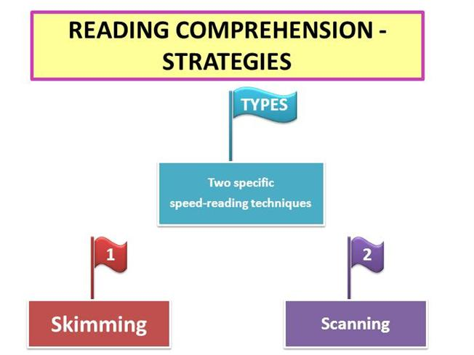

Slide 2
SKIMMING
When you're reading you don’t have to read everything with the same amount of care and attention. Sometimes you need to be able to read a text very quickly.
There are three kinds of skimming.
Pre-read skimming refers to preparing to read.
Skim reading refers to situations in which skimming is the only coverage you plan to give the material.
Review skimming assumes that you have already read the material and are going to back over it as a means of study.

